Slide 1

United Nations
End of Life Vehicles Recycling Initiative

Slide 2
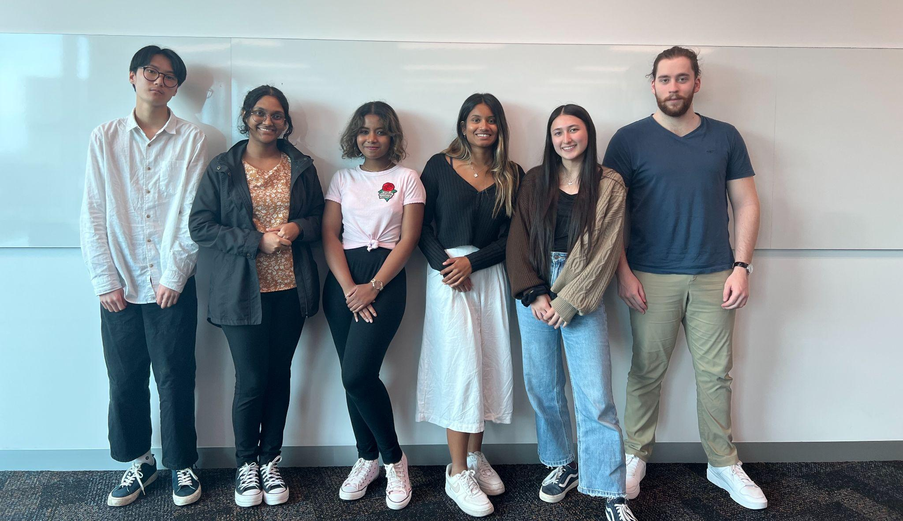
Come meet the team!
Asmita
Business
Jaewon
Computer Science
Will
Mechanical Engineering and Econometrics
Sumiki
Mechatronics Engineering
Emily
Science and Commerce
Shehara
Science

Slide 3






Come meet the team!
Jaewon
Research investigator & Evaluator
Shehara
Implementer and shaper
Will
Monitor and Evaluator
Jaewon
Resource Investigator & Evaluator
Emily
Resource investigator and team worker
Asmita
Organiser, Generates ideas
Sumiki
Evaluator and Team Worker

Slide 4
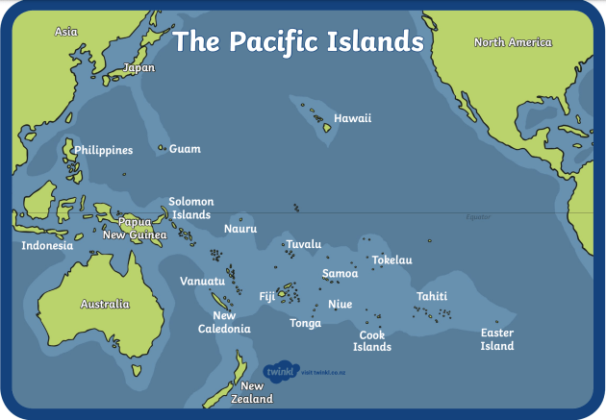
What is our challenge?
Which country out of Fiji, Samoa and Papua New Guinea would be most economically sustainable in operating a nonexclusive regional recycling initiative for end-of-life-vehicles (ELVs)?
Notes:
Explain what ELV’s are and the objective of this initiative - (e.g to eliminate the mass waste of vehicles that are dumped and abandoned, the hazardous waste that sits in the vehicles etc.)

Slide 5
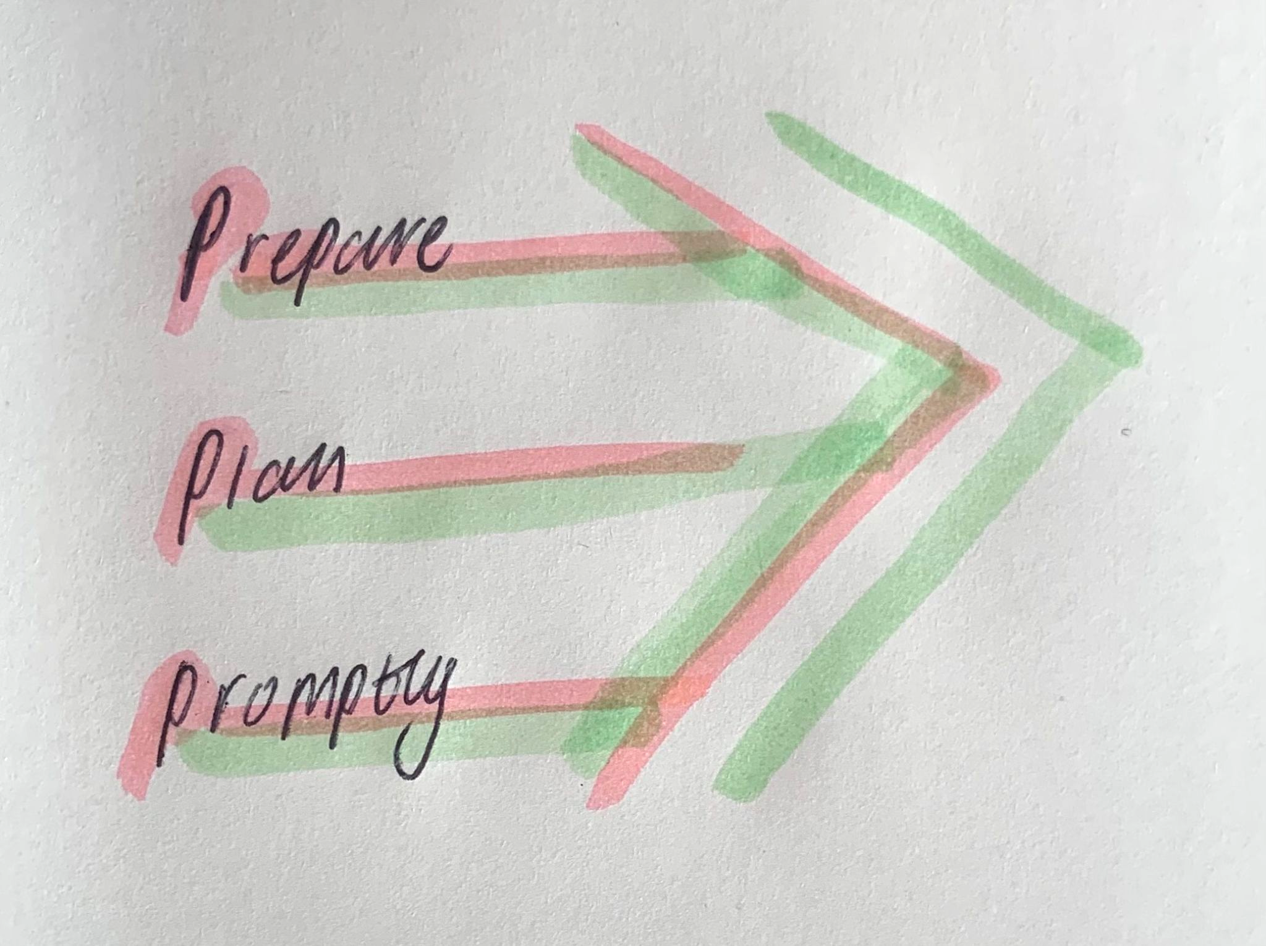
Our Focus
To develop a process that carefully selects the country that is the best option to establish the ELV recycling initiative
Positive impact on jobs
Safe removal of hazardous chemicals in ELVs
Fulfil many of the SDGs
Human Centred Approach
Key Users
UN
Intergovernmental Organizations
Samoa
Fiji
Papua New Guinea
Primary Goal

Slide 6
Challenge Map
[1], [2]
Political
Political Stability, Civil unrest, Governments etc.
Long -term Sustainability (>5 years)
Economical
Sale of recycled materials, cost of building infrastructure, etc.
Sustainability and Viability
OUR CHALLENGE
Social
Local businesses, effect on labour, human rights, Local population etc.
Short-term Sustainability (≤5 years)
Technological
Current infrastructure, automation, etc.
Disposal of POP’s, unrecycled waste, Relative location of country, size of country
( Geographical space) , etc.
Stakeholders
Environmental
UN, Swire Shipping Investment etc.
Legal
Regulations and laws, Policy Makers etc.
Notes:
Come back to this and work through the rubric ensure all points are addressed and references are cited

Slide 7
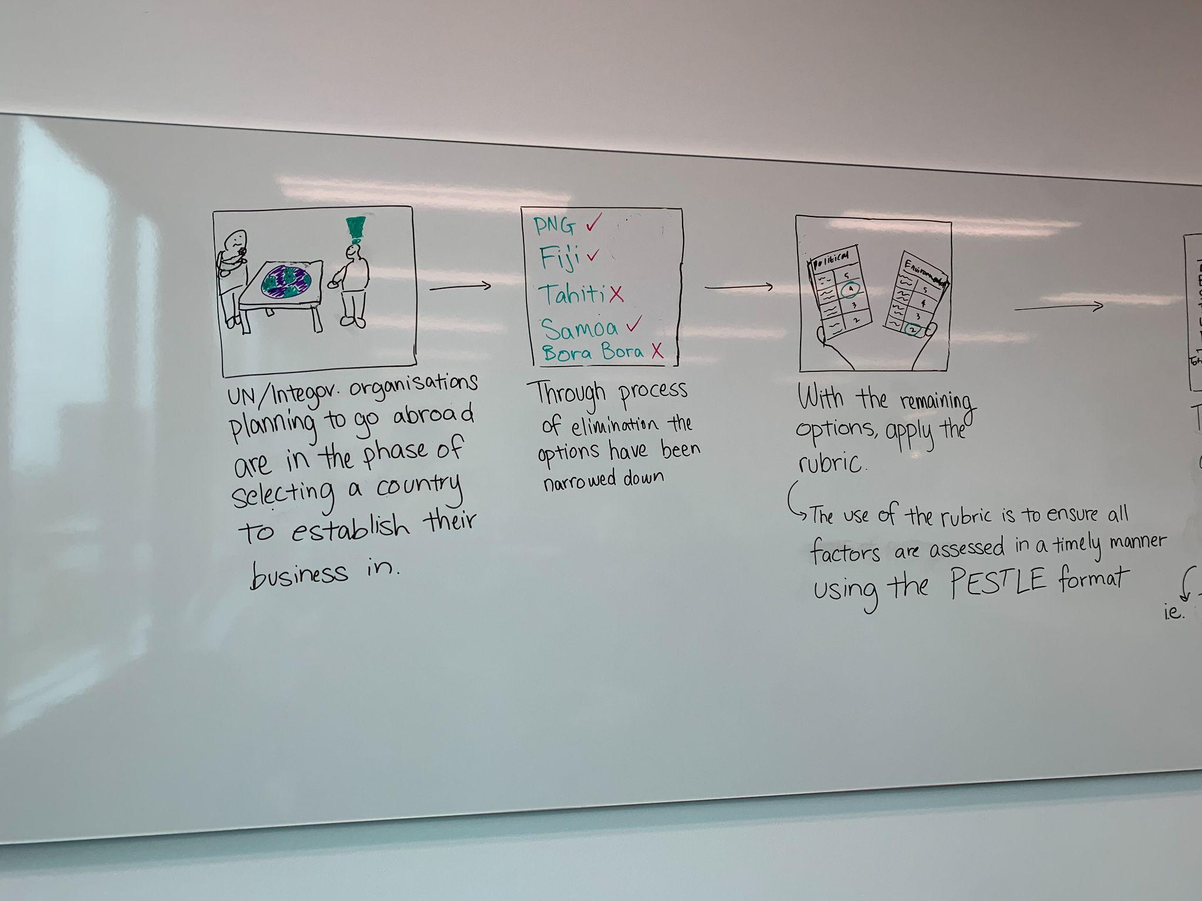
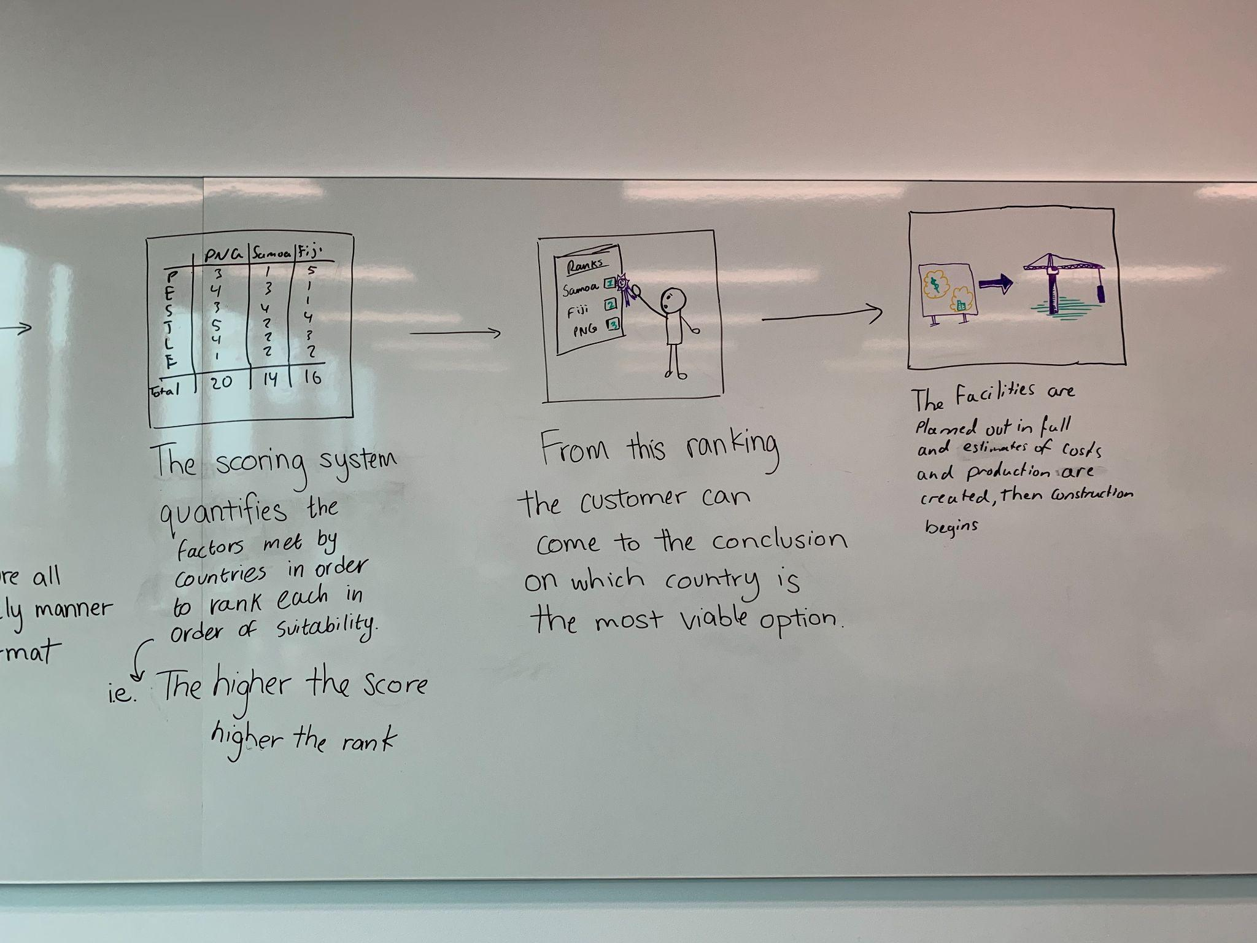
Storyboard
[3], [4]
PAST
PAST
PRESENT
PRESENT
UN/intergovernmental organizations select a region
Narrowing down the options
Apply the rubric and assess them in a timely manner using PESTLE
Sum up the scoring and rank countries in order of suitability

Slide 8
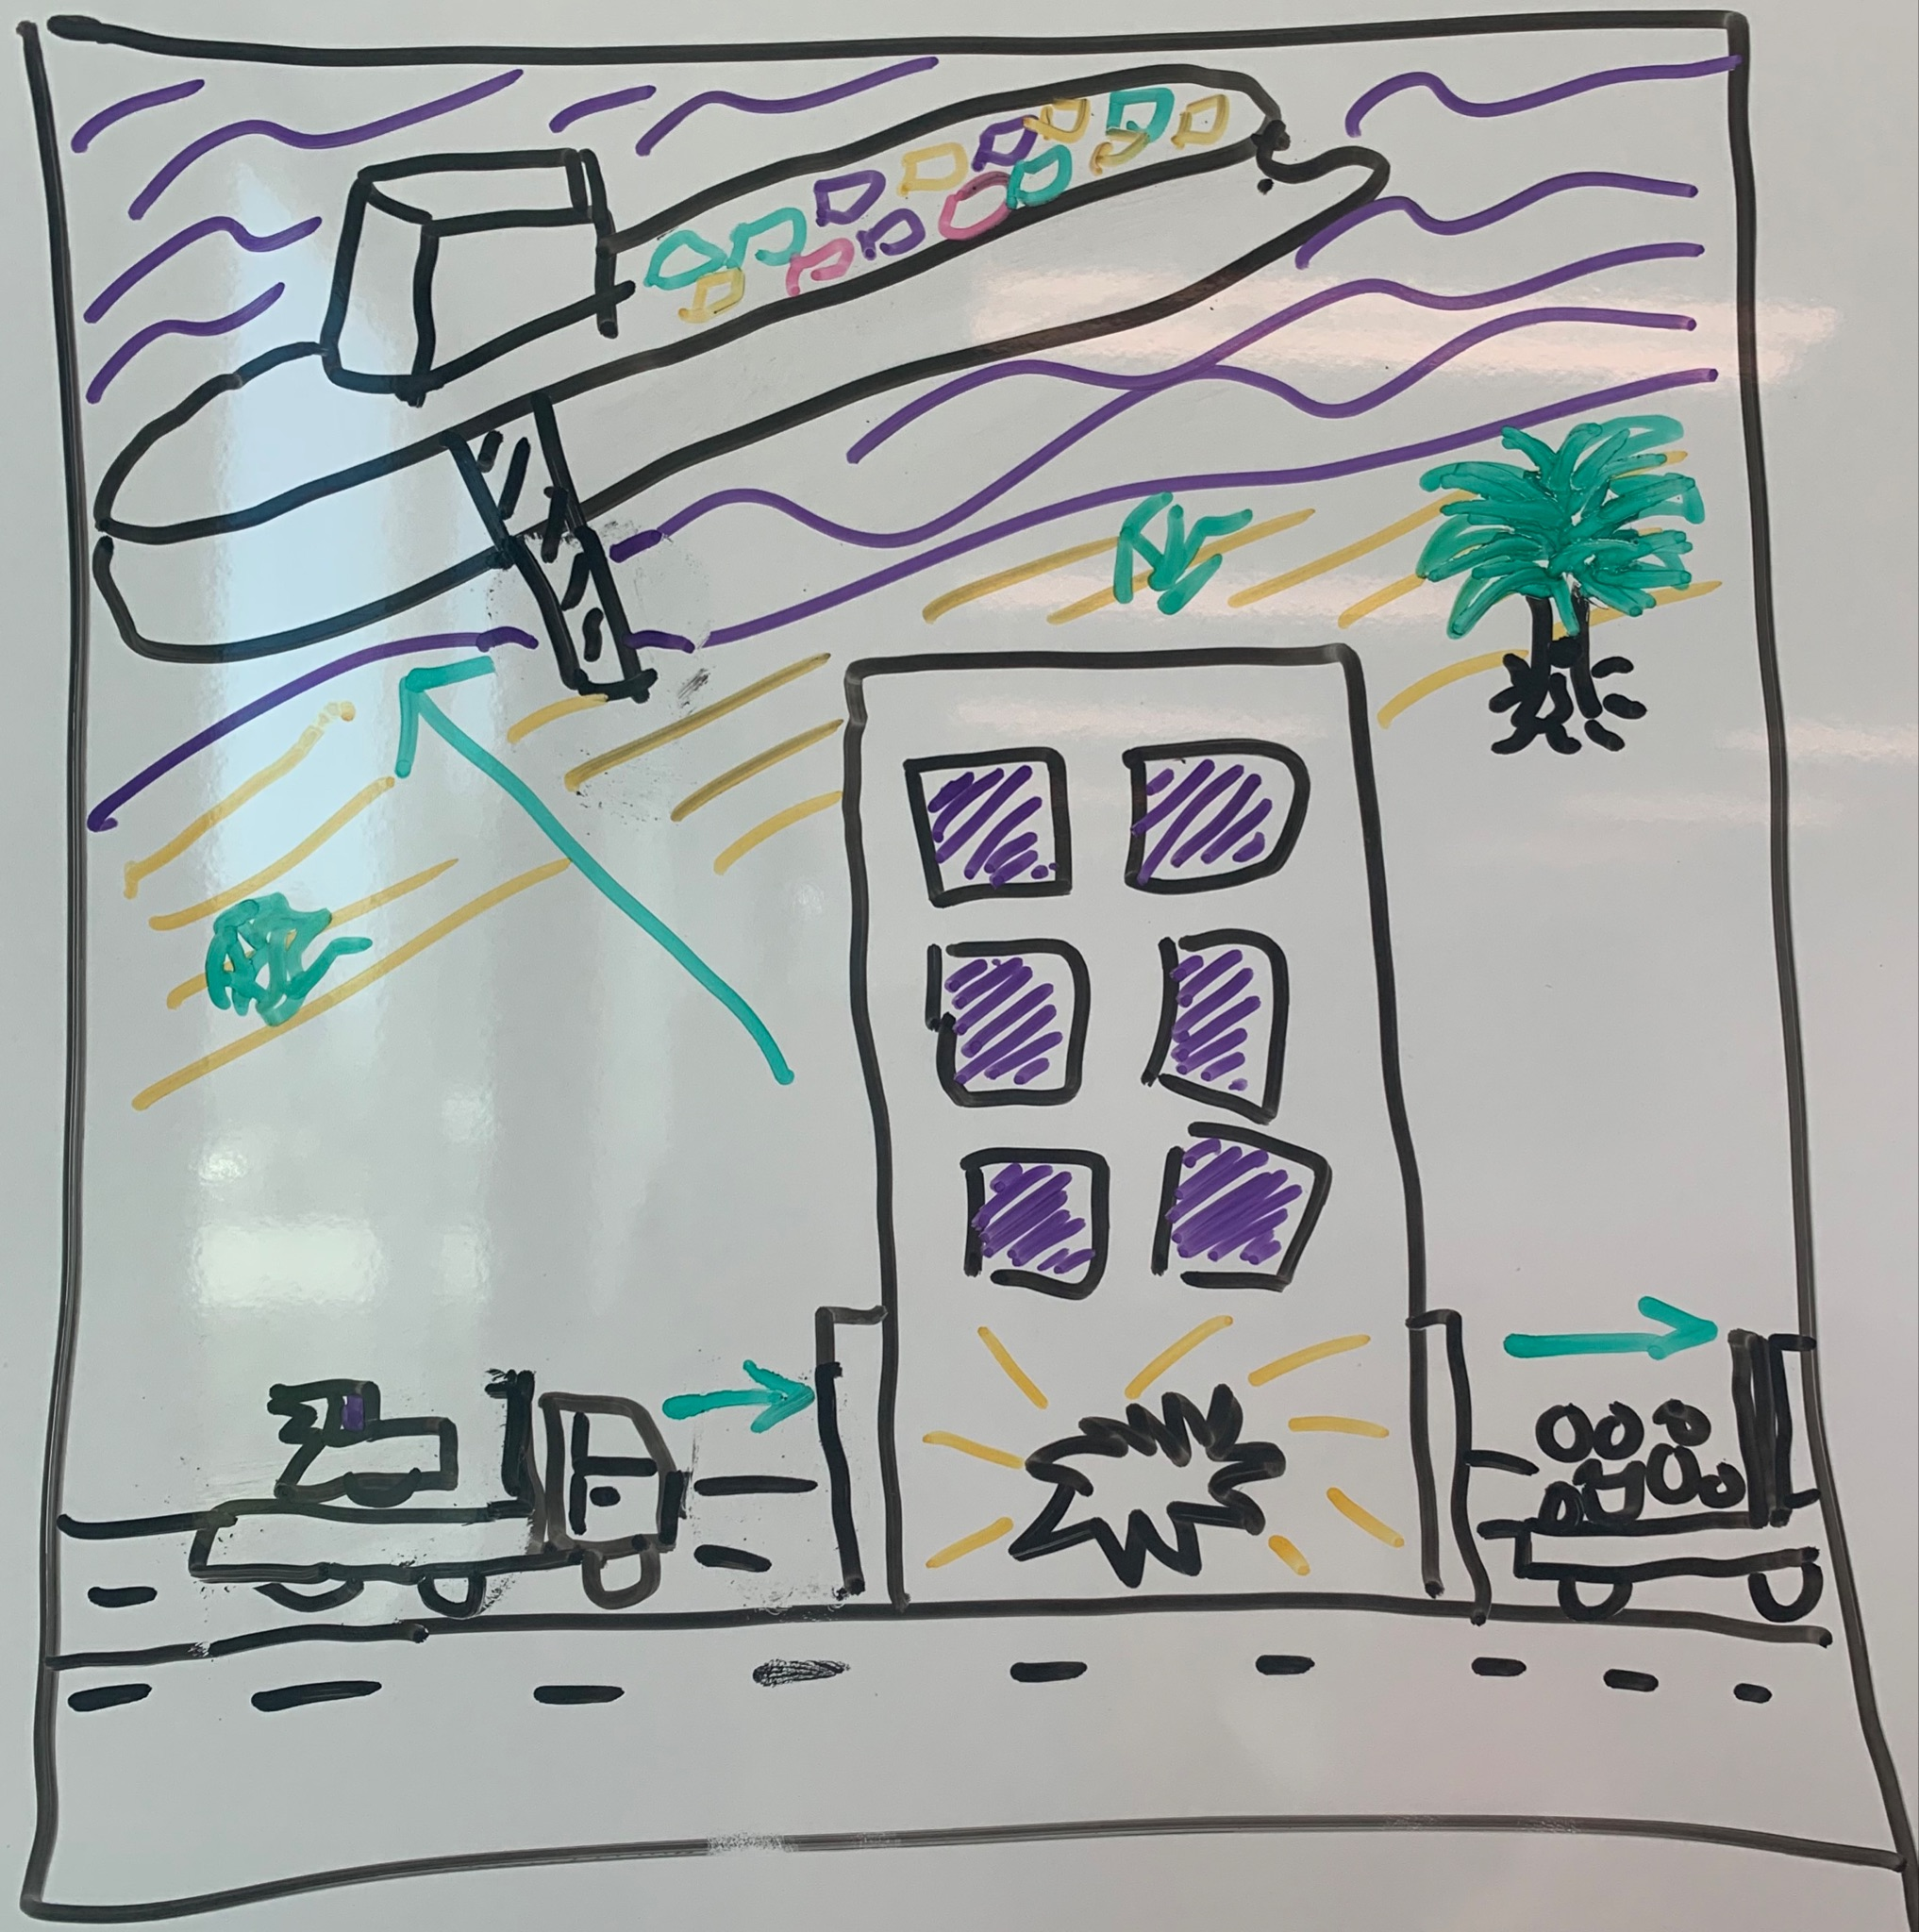
Storyboard
[5], [6]
FUTURE
FUTURE
FUTURE
Selecting the most optimum country
Plan out facilities and estimate cost, then begin construction
Industry is established that contributes to SDGs and is economically sustainable. .

Slide 9
Assessment Rubric |  | Countries
Factors | Criteria | Country 1 | Country 2 | Country 3
Political | Statement 1 Statement 2 Statement etc. | /5 | /5 | /5
Economical | Statement 1 Statement 2 Statement etc. | /5 | /5 | /5
Social | Statement 1 Statement 2 Statement etc. | /5 | /5 | /5
Technological | Statement 1 Statement 2 Statement etc. | /5 | /5 | /5
Environmental | Statement 1 Statement 2 Statement etc. | /5 | /5 | /5
Legal | Statement 1 Statement 2 Statement etc. | /5 | /5 | /5
Total |  | /30 | /30 | /30
Notes:
This is a more digestible way for the audience to understand the layout and then can decompose the lay out using the legal component

Slide 10
Legislative capacity to support new recycling initiatives
Efficiency of drafting, enforcement and implementation
Legal
Regulatory frameworks for waste treatment and management
Coherence of waste management responsibilities

Slide 11
Legal
Criteria | Fiji | Samoa | PNG
Extensive legislative and regulatory frameworks for waste management and treatment. Great coherence in the range of responsibilities for waste management and treatment operations Exceptional level of efficiency in drafting, enforcement and implementation. Great legislative capacity to support newly formed and ongoing recycling operations. | 5 | 5 | 5
High level legislative and regulatory frameworks for waste management and treatment. Coherence in range of responsibilities for waste management and treatment operations. Good efficiency in drafting, enforcement and implementation. | 4 | 4 | 4
Satisfactory level of legislative and regulatory frameworks for waste management and treatment. Acceptable level of coherence in range of responsibilities for waste management and treatment operations. Satisfactory level of effectiveness of operations bound by legal frameworks. | 3 | 3 | 3
Low level legislative and regulatory frameworks for waste management and treatment. Poor efficiency in drafting, enforcement and implementation. Lack of coherence in range of responsibilities for waste management and treatment operations. | 2 | 2 | 2
There are no legislative and regulatory frameworks for waste management and treatment. Unsatisfactory level of responsibilities of operations. | 1 | 1 | 1

Slide 12
Total
[7], [8], [9], [10]
Criteria | Fiji | Samoa | PNG
Political stability | 4 | 3 | 3
Economical viability | 4 | 2 | 2
Social Factors | 3 | 4 | 2
Technological advancement | 3 | 2 | 2
Legal viability | 3 | 2 | 4
Environmental sustainability | 3 | 3 | 4
Total | 20 | 16 | 17

Slide 13
Our Insight Draw
[11], [12]
Synthesis of feedback
Modify the scoring layout (Make it a dropdown instead)
Implement a weighting system
Develop a user guide to make it easy to use which shows aims, decisions and process
Consider how countries use varying methods to measure sustainability eg. What if a country doesn’t follow a quantitative format in economics but a index of happiness as a reflection of the economy?

Slide 14
Next Steps
What’s next
First round of testing is COMPLETE
Revise the prototype to address the concerns raised mentioned prior
Conduct more rounds of testing and incorporate feedback
Final product is introduced through a consultative process with the UN
Once a consensus is reached,
final product released

Slide 15
References
Challenge map:
[1] What is PESTLE analysis? An important business analysis tool. (2022, April 22). PESTLE Analysis. https://pestleanalysis.com/what-is-pestle-analysis/
[2] Mapping a way forward for recycling of bulky waste in the Pacific. (n.d.). Pacific Environment. https://www.sprep.org/news/mapping-a-way-forward-for-recycling-of-bulky-waste-in-the-pacific
Storyboarding:
[3] Dixon Ho - UNEP Representative
[4] Team, V. (2015). What Is A Storyboard And Why Do You Need One? | Vyond. Vyond.com. https://www.vyond.com/resources/what-is-a-storyboard-and-why-do-you-need-one/
[5] NetSuite.com. (n.d.). Scenario Planning: Strategy, Steps and Practical Examples. Oracle NetSuite. https://www.netsuite.com/portal/resource/articles/financial-management/scenario-planning.shtml#:~:text=Scenario%20planning%20helps%20decision%2Dmakers
[6] Recycling Market Research Report | Green Growth Knowledge Partnership. (n.d.). Www.greengrowthknowledge.org. Retrieved January 19, 2023, from https://www.greengrowthknowledge.org/research/recycling-market-research-report
Prototyping:
[7] Department of Agriculture, Water and the Environment Disposal of wastes containing persistent organic pollutants. (n.d.). Retrieved January 19, 2023, from https://www.dcceew.gov.au/sites/default/files/documents/disposal-wastes-containing-persistent-organic-pollutants.pdf
[8] Papua New Guinea GDP Annual Growth Rate - 2021 Data - 2022 Forecast. (2021). Tradingeconomics.com. https://tradingeconomics.com/papua-new-guinea/gdp-growth-annual
[9] (n.d.). Samoa [Review of Samoa]. Green Growth Knowledge; Green Policy Platform. https://www.greengrowthknowledge.org/country/samoa
[10] (n.d.). Papua New Guinea [Review of Papua New Guinea]. Green Growth Knowledge; Green Policy Platform. https://www.greengrowthknowledge.org/country/papua-new-guinea
Insights:
[11] Hoeffler, A., & Outram, V. (2011). Need, merit, or self‐interest—what determines the allocation of aid?. Review of Development Economics, 15(2), 237-250.
[12] SPREP Library Cataloguing-in-Publication, Moana taka partnership: A guide for Pacific Island, Countries & Territories. Apia, Samoa: SPREP, 2020. 19 p. 29 cm.
ISBN: 78-982-04-0900-2

Slide 16
THANK YOU!

